Slide 1
Educating All Students:
Focus on English Language Learners
Competency 0002
Martha Young, SUNY New Paltz
November 20, 2013

Slide 2
Agenda
Content Objectives:
Language Objectives:
Understand how literacy development in the first (home) language influences literacy development in an additional (2nd language).
Explore types and benefits of language development models, bilingualism, and bilingual programs.
Select from a variety of techniques for adapting content to the students’ proficiency and cognitive levels.
Develop a lexicon related to learning an additional language.
Discuss the challenges of school reform and its effect on English learners.
Explain the importance of meaningful academic activities for English learners.

Slide 3

Notes:
Who are English language learners? How does language impact every facet of our lives? No matter how high quality our instruction is in a multicultural environment, students who experience hostility, negativity or a lack of support for the many cultural, social and linguistic facets of their lives will never be academically successful.

Slide 4
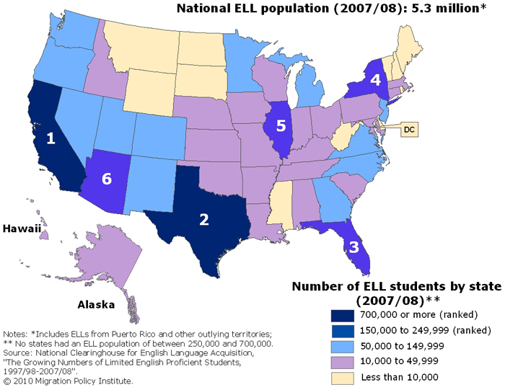
First, demographics…and the numbers keep rising
Every state in the nation is experiencing the effects of this growth. School districts, even the smallest ones, face the challenge of developing programs and services to help these students learn English, as well as math, science, social studies, and language arts.
Notes:
All over the United States, growth of minority populations in public and private schools is rising, and the rate of that growth is increasing year by year. In the 11 school years from 1993—1994 to 2003—2004, the number of language learners in public schools, kindergarten to twelfth grade, rose 65.03% to just over 5 million. Total public school enrollment during those same years increased only 9.19% (National Clearinghouse of English Language Acquisition, 2005).
Schools, and teachers are held accountable to demonstrate yearly progress of all students, including ELLs. The challenge affects teachers of every grade level and subject area. The challenge is hard, and stakes are high—each year they seem to get harder and higher.

Slide 5
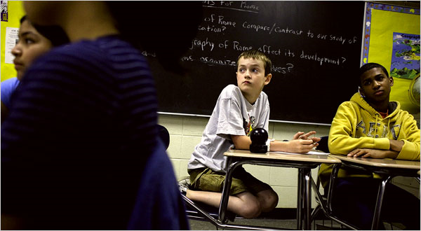
Think of your future classroom and daydream a little…

Slide 6
Elena
My Spanish isn’t good enough
I remember how I’d smile
Listening to my little ones
Understanding every word they’d say,
Their jokes, their songs, their plots
Vamos a pedirle dulces a mama. Vamos.
But that was in Mexico.
Now my children go to American High Schools.
They speak English. At night they sit around the
Kitchen table, laugh with one another.
I stand at the stove and feel dumb, alone.
I bought a book to learn English.
My husband frowned, drank more beer.
My oldest said, 'Mama, he doesn’t want you to
Be smarter than he is.’ I’m forty,
Embarrassed at mispronouncing words,
Embarrassed at the laughter of my children,
The grocer, the mailman. Sometimes I take
my English book and lock myself in the bathroom,
say the thick words softly, for if I stop trying, I will be deaf
when my children need my help.
Notes:
Pat Mora poem
Think of your future classroom. Then, daydream a little.
Read the poem “Elena.”
Anecdote about learning an additional language…implications for the adolescent learner in American schools. (Julio)
How and what we learn about language goes much deeper than the words we are able to eventually articulate. What happens to family dynamic/roles in the face of English? What long-term effects does our instructional intention have on our students?

Slide 7
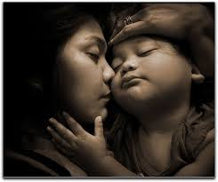



Poetry and Verse: Painting with Words
Notes:
Think of your future classroom. Then, daydream a little.
Read the poem “Elena.” Focusing on the noun content of the poem, look at visuals. Select the picture(s) that most closely represents the nouns in the poem.
Highlight suitable phrases or words.
Using the phrases and words that resonate with you, write a poem or narrative that characterizes an English language learner in an American High School. What might be the successes and challenges of an ELL?

Slide 8
Theoretical Foundations
Why theory first?
Notes:
Good teachers make good choices, and good choices are grounded in theory. To help ELLs, content teachers must become familiar with select second-language acquisition principles and theory.
The instructional and assessment strategies presented in this workshop help increase the comprehensibility of content through activities and assignments. Understanding the theories that inform these strategies empowers you to make the best choices and combinations.

Slide 9

Theoretical Foundations
Cummins’s differentiation between social and academic language
Krashen’s separate concepts of the affective filter and comprehensible input
Vygotsky’s zone of proximal development
Swain’s ideas about meaningful interaction
Brown’s principles of language teaching and language learning
Bloom’s taxonomy classifying levels of cognitive challenge

Slide 10
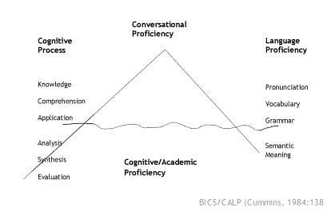
Cummins: Differentiation of Social and Academic Language
Notes:
Jim Cummins (1984) contributed the concept that the language of the classroom requires more cognitively demanding language skills than the language of the outside world. He used the terms cognitive language proficiency, or CALP, to describe the language of the classroom and basic interpersonal communication skills, or BICS , to describe the social language of everyday life. Researchers, in recent years, have taken some issue with the specificity of these concepts a separate entities, refuting them as too simplistic and reductionist. Although some of these arguments may indeed be valid, Cummins general concept about the differing demands of language usage inside and outside the classroom is still an important one for content teachers.

Slide 11

Understanding Social Language
Language is a social construct: The purpose of language is communication.
Notes:
In a process closely resembling first language acquisition, children learning English communicate to make friends with other children and to participate in the youth culture of sports, games, music, TV, video games, movies, fads, and fashion. They develop the social language skills of everyday activities through a process of natural acquisition by becoming immersed in the English-language-rich environments surrounding these activities. They learn to retell events, describe activities, express personal opinions, and maintain conversation. Children learning English develop these social skills with apparent ease.

Slide 12

Understanding Academic Language
The language of the classroom requires students to use language that is conceptually demanding and cognitively complex.
Notes:
Unlike the social language used to retell events, talk about experiences, describe activities, and give personal opinions, academic assignments require students to use different forms of language to accomplish the following: compare, contrast, list, define, order, classify, describe, predict, explain, discuss, analyze, infer, justify, integrate, evaluate, deduce, argue, persuade, defend. The challenge inherent in these uses of academic language for ELLs is made even more difficult by the need to apply them in all modalities of communication: speaking, listening, reading, and writing.

Slide 13
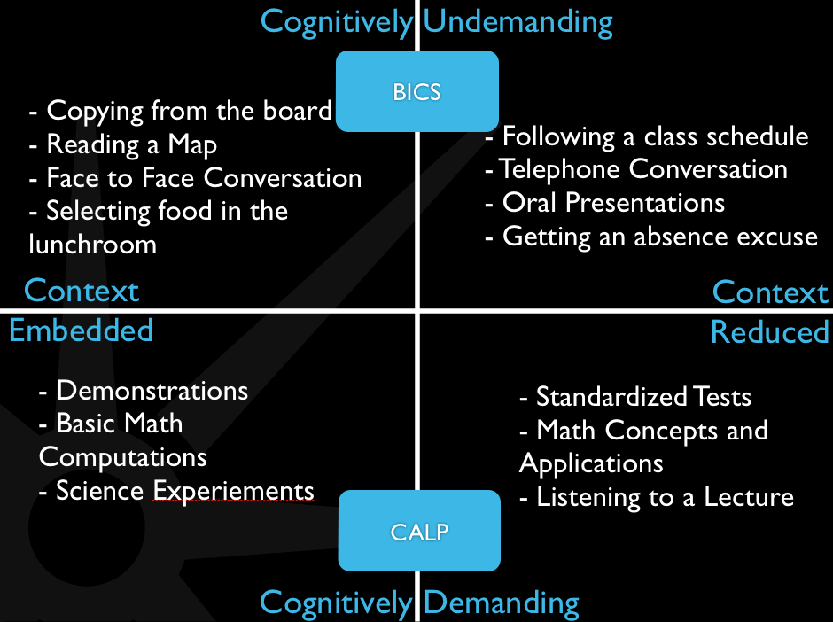
Making Academic Language More Comprehensible

Slide 14

Using Cummins’s Principles
In academics, scaffolds provide ELLs with the support they need to learn content while they are developing their English skills. In ways figuratively similar to construction, scaffolding strategies allow language learners better access to content material.

Slide 15
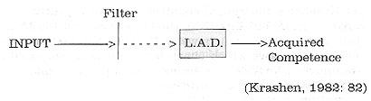
Krashen: The Affective Filter
As part of his five-hypothesis Monitor Model of Second Language Acquisition, Stephen Krashen (1982) proposed the existence of an emotional filter that influences how much actual learning takes place in relation to input. The strength of the filter itself is determined by affective factors of learner anxiety, self-confidence, and motivation.
Notes:
The Comprehensible Input Hypothesis. He represented his idea in the formula i+1, in which I is input—comprehensible input based on real communication that is immediately comprehensible to the language learner—and +1 is the next level where language is advanced just enough so the learner is challenged by it but able to learn it. This is the “teachable/learnable area”– the area between a student’s actual and potential language development.

Slide 16
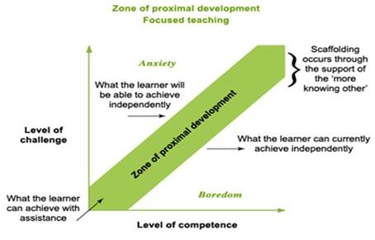
Vygotsky: Zone of Proximal Development
Notes:
Applying the ZPD to the content classroom addresses process issues rather than product issues. Students learn most effectively by becoming active participants in their own learning. Students will progress to their fullest potential when teachers scaffold instruction with activity and assignment strategies that encourage working with teachers and peers, individually and in groups, in an atmosphere of guidance and collaboration.

Slide 17
Swain: Meaningful OUtput
“…the meaning of ‘negotiating meaning’ needs to be extended beyond the usual sense of simply ‘getting one’s message across.’ Simply getting one’s message across can and does occur with grammatically deviant forms and sociolinguistically inappropriate language. Negotiating meaning needs to incorporate the notion of being pushed toward the delivery of a message that is not only conveyed, but that is conveyed precisely, coherently, and appropriately. Being ‘pushed’ in output…is a concept parallel to that of the i +1 of comprehensible input. Indeed, one might call this the ‘comprehensible output’ hypothesis.”
(Swain, 1985, 248-9).
Notes:
Swain’s concept of meaningful output has direct bearing on learning in content classrooms. The concept highlights the importance of small group interaction in long-term retention of both language and conceptual knowledge. \Content teachers can promote learning by choosing strategies that encourage students to negotiate meaning through paired or small group discussion. ELLs, in meaningful academic conversation with their peers, receive input and feedback that allow them to compare their language (vocabulary, pronunciation, structures) and their conceptual understandings with those of their native-speaking peers. Manipulating language in meaningful classroom interaction clarifies input and makes it more comprehensible for ELLs.

Slide 18
Brown’s Principles at a Glance
Meaningful Learning
Intrinsic Motivation
Strategic Investment
Self-Confidence
Risk Taking
Language-Culture Connection
Notes:
Resonant Themes in Effective Literacy Development Research
The role of engagement and motivation in literacy development
The requirement that students be actively involved in making meaning from text
The interconnectedness of reading, writing, speaking, listening, and thinking
The need to integrate both generic and discipline-specific literacy strategies throughout the content areas in order to maximize learning

Slide 19
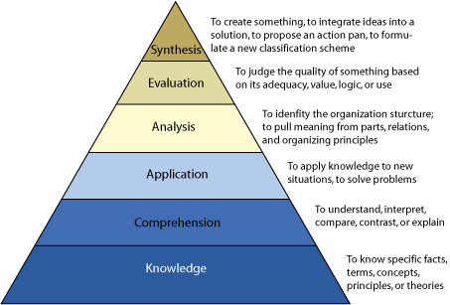
Bloom: Taxonomy

Slide 20
A Comparison: First and Second Language Acquisition
Similarities
Construct language from prior conceptual knowledge
Active learners who test and revise hypotheses
Usually more cognitively developed
Require an interactional process
Use cognitive strategies
Aided by modified input
Predictable stages
Make developmental errors
Require a silent period
Differences
Greater knowledge of the world
Can learn and apply rules more easily
Has more control over the input
Has L1 as a resource
May have other languages from which to draw
Is familiar with one or more cultures
May have a problem with attitude and/or motivation
More likely to be inhibited, anxious, and/or afraid of making errors
Notes:
Similarities appear in the process of language acquisition.
Differences appear to lie in the areas of level of cognitive development and affect.
Source: Richard-Amato, P. A. (1996). Making it Happen: Interaction in the SL Classroom. Longman.

Slide 21
Every man’s mind is…modified by all the objects of Nature and art; by every word and every suggestion which he ever admitted to act upon his consciousness; it is the mirror upon which all forms are reflected and in which they compose one form.
-- Percy Bysshe Shelley
Prometheus Unbound
Notes:
What does it mean to know a language?

Slide 22

Federal Statutes and Program Models

Slide 23
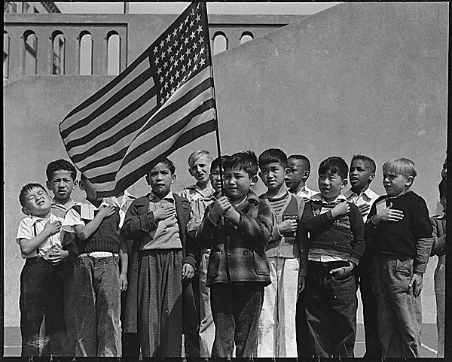
Lau v. Nichols
The 1974 Supreme Court case Lau v. Nichols resulted in perhaps the most important court decision regarding the education of language-minority students. This case was brought forward by Chinese American students in the San Francisco Unified School District who were placed in mainstream classrooms despite their lack of proficiency in English, and left to "sink or swim." The district had argued that it had done nothing wrong, and that the Chinese American students received treatment equal to that of other students.
Notes:
The influence of Lau on federal policy was substantial. After the court's decision, the U.S. Department of Education's Office of Civil Rights created the Lau Remedies. Whereas Title VII Bilingual Education Act regulations applied only to funded programs, the Lau Remedies applied to all school districts and functioned as de facto compliance standards.

Slide 24
The essence of Lau was codified into federal law though the Equal Educational Opportunities Act of 1974 (EEOA), soon after the case was decided. Section 1703(f) of this act declares: "No state shall deny educational opportunities to an individual on account of his or her race, color, sex, or national origin by … (f) the failure of an educational agency to take appropriate action to overcome language barriers that impede equal participation by its students in its instructional programs."
Equal Educational Opportunities Act of 1974 (EEOA),

Slide 25

Serna v. Portales
The judge declared, "It is incumbent on the school district to reassess and enlarge its program directed to the specialized needs of the Spanish-surnamed students" and to create bilingual programs at other schools where they are needed. This case was first decided in 1972. Later it was appealed to the 10th Circuit Court of Appeals and decided in 1974 just six months after Lau. Like Lau, it makes clear that schools cannot ignore the unique language and educational needs of ELL students.
Notes:
Serna v. Portales (1974) was the first case to raise the issue of bilingual education outside of the context of desegregation (Del Valle, 2003). The case dealt with a White-majority school in New Mexico that failed to meet the unique needs of "Spanish-surnamed students." It was argued under Title VI of the Civil Rights Act of 1964, which prohibits discrimination on the basis of "race, color, or national origin" in any program that receives federal funding. The court found the school's program for these students to be inadequate..

Slide 26

A major outcome of this case is a three-pronged test to determine whether schools are taking "appropriate action" to address the needs of ELLs as required by the EEOA.
Castañeda v. Pickard
The Castañeda standard mandates that programs for language-minority students must be
(1) based on a sound educational theory,
(2) implemented effectively with sufficient resources and personnel, and
(3) evaluated to determine whether they are effective in helping students overcome language barriers (Del Valle, 2003).
Notes:
The right to bilingual education suffered a blow in 1981 in Castañeda v. Pickard. The case originated in Texas, where plaintiffs charged that the Raymondville Independent School District was failing to address the needs of ELL students as mandated by the EEOA. The federal court ignored the old assumption that Lau and the EEOA mandated bilingual education. Nevertheless, it did find that Raymondville fell far short of meeting the requirements of the EEOA

Slide 27

1982
Plyler v. Doe
U.S. Supreme Court denies the states' right to exclude the children of illegal immigrants from public schools.

Slide 28
No Child Left Behind
Federal policy for language-minority students learning English changed dramatically with the passage of the No Child Left Behind Act of 2001 (NCLB) (Public Law 107-110),
Bilingual Education Act became Title III: Language Instruction for Limited English Proficient and Immigrant Students
Office of Bilingual Education and Minority Language Affairs (responsible for administering Title VII grants) became Office of English Language Acquisition, Language Enhancement, and Academic Achievement for Limited English Proficient (LEP) Students
The National Clearinghouse for Bilingual Education became The National Clearinghouse for English Language Acquisition and Language Instruction Educational Programs
LEP student issues are also featured prominently in changes to Title I, "Improving the Academic Achievement of the Economically Disadvantaged," which addresses issues of accountability and high-stakes testing.

Slide 29

No Child Left Behind
Whereas grants under the former Title VII Bilingual Education Act were competitive, Title III provides formula grants to state education agencies. These agencies, in turn, make subgrants to eligible local education agencies (i.e., school districts and charter schools) that apply to the state for the funds. The funds doubled but because these federal funds are now spread more thinly, fewer dollars are available for each eligible LEP student.
Unlike recent versions of the Bilingual Education Act, Title III does not make any distinctions between bilingual and nonbilingual programs. The federal law now requires only that LEP students be placed in "language instruction education programs.
Also unlike Title VII, Title III includes no recognition of the personal and societal benefits of bilingual education and bilingualism. Nor is there any acknowledgment of the factors that have negatively impacted the education of LEP students, such as segregation, improper placement in special education, and underrepresentation of LEP students in gifted and talented education and shortages of bilingual teachers. Not addressed are issues of cultural differences or the need for multicultural understanding.
The sole focus of Title III is English. The list of purposes stresses repeatedly that Title III funds and programs are to "ensure that LEP students attain English proficiency, develop high levels of academic attainment in English, and meet the same challenging State academic content and student academic achievement standards as all children are expected to meet" and to assist state and local education agencies in creating "high quality instructional programs" that prepare LEP students to "enter all-English instruction settings" (NCLB §3102).

Slide 30

What do you think:
“Doesn’t it just make sense that the earlier and more intensively children are placed in all-English instruction at school the better their English achievement will eventually be?”
Notes:
Share the prevalent belief that you thought was true. How prevalent do you believe this conclusion is? Where do you think this belief comes from?

Slide 31
Different Programs = Different Goals
ESL
    Instruction for ELLs in an English educational environment
    Focus on English language acquisition and academic content knowledge
    1st language is used to scaffold and differentiate (clarify, pre-teach, re-teach)
Bilingual (Transitional – Developmental)
    Provide instruction in first language (80% Spanish) to support and develop1st language
    Ensure ELLs are learning academic material in Spanish while developing English language
Dual Language Immersion
    ELL’s and Native English Speakers
    Provide instruction in two languages
    Obtain full language proficiency in both targeted languages (1st and 2nd languages)

Slide 32

Service Delivery Models
Instruction in general ed. classroom with ESL/bilingual support
ESL academic content class
ESL newcomer class
Push-In
Pull-Out
Bilingual Instruction

Slide 33
What do we know about teaching literacy to English language learners?

Slide 34
Evidence-Based Reading Instruction
The 5 components of literacy that should be explicitly taught for effective reading instruction:
Phonemic awareness
Phonics
Vocabulary development
Reading fluency
Reading comprehension
Source: National Reading Panel (1997)
Notes:
Note NRP reviewed studies for reading development among English native speakers, not ELLs!
Notes:
Phonemic Awareness - “the ability to notice, think, and work with the individual sounds in spoken words” (Adler, 2001)
Phonics – the predictable relationship between sounds (phonemes) of a spoken language and the letters and spelling (graphemes that represent those sounds in written language (Antunez, 2002)
Vocabulary development
Reading fluency
Reading comprehension
The federal Reading First program was developed based on these findings.

Slide 35
Research Findings: ELL Literacy Development
ELLs often develop decoding and spelling skills to levels equal to their native English-speaking peers.
ELLs’ reading comprehension falls well below that of native English-speaking peers.
The achievement gap between ELLs and non-ELLs grows around 3rd grade.
Source: August & Shanahan (2008), Goldenberg (2008)
Notes:
ELLs often develop word-level skills (decoding, spelling) to levels equal to their native English-speaking peers.
ELLs’ text-level skills (reading comprehension) fall well below those of native English-speaking peers.
The achievement gap between ELLs and non-ELLs grows around 3rd grade, when students move from “learning to read” to “reading to learn” and into more challenging and abstract content.
ELLs need oral language development and general and academic vocabulary knowledge to successfully comprehend text.
(August & Shanahan, 2008; Goldenberg, 2008)

Slide 36
Research Findings: ELL Literacy Development
Explicitly teaching the five components of reading instruction helps ELLs!
BUT reading instruction does not improve ELLs’ literacy as much as it does non-ELLs’ literacy.
SO when working with ELLs, teachers must modify literacy instruction to take into account students’ language needs.
Source: August & Shanahan (2008), Goldenberg (2008)

Slide 37

What types of linguistic knowledge do you need to determine the elements of the following Equation?
Veronica recycles 10 bottles of soda each week. How many bottles of soda does Veronica recycle in 6 months?
Notes:
Morphological – knowledge of words and lexicon, including the role of each word as far as the parts of speech are concerned (nouns, adjectives, adverbs, etc.)
2. Syntactic– knowledge of how words combine in a language to be able to understand and identify important grammatical information that will allow the student to determine the elements of her equation in the right order.
3. Phonological /phonetics– knowledge of how words are pronounced, if we expect the student to be able to orally communicate her answer to the rest of the class.
4. Semantic– knowledge of the meaning of words.

Slide 38
The following answers would not be expected from students who master the English language…
Recycled 240 bottles
Veronica recycled 240 bottles
Veronica will recycle 240 bottles
Veronica had recycled 240 bottles
To support content and literacy
  Content Objective
    Students will learn to solve story problems using simple equations
  Language Objective
    Students will be able to answer orally the questions related to story problems formulated in the simple present tense.

Slide 39
Students Who Are College and Career Ready: Particularly Important Skills for ELLs
Demonstrate independence
  Request clarification and ask relevant questions
  Become self-directed learners, effectively seeking out and using resources to assist them
    Resources include teachers, peers, print and digital reference materials
    Other resources (not listed in the standards, but important) include first language knowledge and skills; strategies to use context to make sense of text

Slide 40
Students Who Are College and Career Ready: Particularly Important Skills for ELLs
They respond to the varying demands of text
  They set and adjust purpose for reading, writing, speaking, listening, language use as warranted by the task
They come to understand other perspectives and cultures*
  Communicate effectively with people of varied backgrounds
  Read literature representative of a variety of cultures and world views
    *skills particularly important for mainstream students also

Slide 41
Speaking and Listening Standards: Particularly Important Skills for ELLs
Prepare for and participate effectively in a range of conversations and collaborations with diverse partners, building on other’s ideas and expressing their own clearly and persuasively
  L2 acquisition occurs through meaningful interactions with native L2 speakers
Ask and answer questions in order to seek help, get information, or clarify if something is not understood

Slide 42
Language Standards: Particularly Important Skills for ELLs
Apply knowledge of language to understand how language functions in different contexts, to make effective choices for meaning and style, and to comprehend more fully when reading or listening
  Knowledge of language should include
    Pragmatic knowledge – knowledge of language use in context (status/purpose of speaker, genre structures)
    Linguistic knowledge– knowledge of the functional demands of writing and speaking (e.g., formulate questions, compare/contrast, summarize, draw conclusions)
Recognize variations from standard English in their own and others’ writing and speaking and identify and use strategies to improve expression on conventional language

Slide 43



Perhaps the most important thing to keep in mind is that an individual’s background in their first language has the most impact on how fast they will learn a second language.
In other words, the better they speak, read, write and listen in their first language, the better and faster they will learn their second language.
Notes:
The truth of the matter is that research clearly tells us that the most important impact on second language acquisition is a person’s background in their first language.

Slide 44
Instructional Practices
Supporting ELL instruction in the Mainstream Classroom

Slide 45
Reading Comprehension
“The synthesis of personality moderators of interpersonal expectancy effects in laboratory experiments calculated five combined z scores and probabilities, one for each of five personality dimensions. The study was used as a unit of analysis, and each study was weighted equally. It was found that experimenters with a greater need for social influence were more likely to generate interpersonal expectancy effects. The combined z score, based on eight studies, was 2.94, with an associated p level of .0032 (two-tailed). The Fail-safe N, the number of null summing studies needed to raise the combined probability above p = .05, was 10.02, or 11.”
Source: Harris Cooper (1998)

Slide 46
Partner Talk
Can you read this paragraph fluently?
Can you understand it?
  Why?
  Why not?
Notes:
Unless they have studied statistics, most teachers will be able to read this paragraph fluently but not comprehend it
Why not?
Not enough background knowledge of the topic
Too many vocabulary words they do not understand – including general words used in new ways

Slide 47
TUNDRA
Tundra is cold, frozen land most of the year. Northern Alaska is tundra. During the winter, the ground is frozen. Days are short. Plants stop growing, and most animals seek shelter from snow and wind. Only animals with thick fur or feathers survive the tundra winters.
Excerpt from Delta Education, Foss Science Stories: Structures of Life (2003)

Slide 48
Could your 3rd grade students read this paragraph fluently?
Would they understand it?
  Why?
  Why not?
What would you need to do in order to help them comprehend this text?

Slide 49
Promising Instructional Practices for ELLs
Teach content, literacy, and language in an integrated and meaningful way.
Scaffold language based on student English proficiency to make sure it is comprehensible.
Build on what students already know and help them develop background knowledge they need.
Explicitly teach vocabulary and academic language (formal language required to be successful in school settings).
Provide ample opportunities for carefully designed interaction with teacher and peers.
Strategically provide native language supports.
Teach reading comprehension strategies explicitly.

Slide 50
Promising Instructional Practices for ELLs
Teach content, literacy, and language in an integrated and meaningful way:
  Teach language through meaningful content and themes, targeting both content and language objectives in every lesson.
  Integrate all four language skills (reading, writing, listening, and speaking) in every lesson.
  Develop English oral language proficiency in the context of literacy instruction.
  Include frequent opportunities to practice reading with a variety of rich materials, in meaningful contexts.
Sources: August & Shanahan (2008); Cloud, Genesee & Hamayan (2009); Echeverria, Vogt, & Short (2007); Goldenberg (2008); Klinger (2006); IES (2007); Short & Fitzsimmons (2007)

Slide 51
Promising Instructional Practices for ELLs
Scaffold language based on students’ English proficiency to make sure it is comprehensible using:
  visuals and realia (objects from real life)
  hands-on materials
  graphic organizers
  gestures
  modified speech
  adapted text (i.e., simple sentence structure, elaboration)
  leveled readers
  repetition / rereading
  narrow reading (reading several texts about the same topic)
Sources: August & Shanahan (2008); Cloud, Genesee & Hamayan (2009); Echeverria, Vogt, & Short (2007); Goldenberg (2008); Klinger (2006); IES (2007); Short & Fitzsimmons (2007)

Slide 52
VIDEO: Instructional Strategies to Accelerate ELL Learning
Scaffolding
  Why is it important to use scaffolding with ELLs?
  What scaffolding strategies will you use in your classroom with ELLs?
  What signals will help you determine when less scaffolding is needed for ELLs?
  What student outcomes do you expect to reach as a result of using scaffolding strategies? Give examples.
  Which new scaffolding strategies will you incorporate in your teaching as a result of viewing this video?
Notes:
Bank Street College of Education

Slide 53
Promising Instructional Practices for ELLs
Build on what students already know and help them develop background knowledge they need.
  Activate and build on students’ background knowledge.
  Validate and build on home and community language, literacy, and culture.
  Use texts with familiar content and topics before moving on to unfamiliar ones.
  Help students develop needed background knowledge on unfamiliar topics and cultures.
Sources: August & Shanahan (2008); Cloud, Genesee & Hamayan (2009); Echeverria, Vogt, & Short (2007); Goldenberg (2008); Klinger (2006); IES (2007); Short & Fitzsimmons (2007)
Notes:
Build on and activate background knowledge (prior learning, prior experience, interests)
Validate, make connections to, and build on home and community language, literacy, and culture.
Use texts with culturally familiar content and topics.
Help students develop background knowledge on unfamiliar topics and cultures through hands on experiences, literature, and discussion.
Good infor but a lot of text again – can you summarize in bullet points?

Slide 54
Why Build Background?
A learner’s “schema” – knowledge of the world – provides a basis for understanding, learning, and remembering facts and ideas found in texts.
Students from culturally diverse backgrounds may struggle to comprehend texts and concepts due to a mismatch in schemata.
Most reading material, such as content area texts, relies on an assumption of common prior knowledge and experience.
Notes:
54

Slide 55
A Bridge to Background Knowledge
Native English speakers’ home culture, home language, prior learning, prior experiences, interests, etc.
Schools’ cultural expectations, academic, literacy, and language demands
English language learners’ home culture, home language, prior learning, prior experiences, interest, etc.
Schools’ cultural expectations, academic, literacy and language demands

Slide 56
Prerequisite for Building on Students’ Background
KNOW YOUR STUDENTS
KNOW YOUR STUDENTS
KNOW YOUR STUDENTS
KNOW YOUR STUDENTS
KNOW YOUR STUDENTS

Slide 57
Who Are Your ELLs?
Languages?
Countries of origin?
Immigration experiences and circumstances?
Cultures (e.g., foods, dress, and traditions; but also values, attitudes, norms of behavior, ways of knowing)?
Home life?
Language proficiency in English (NYSESLAT)?
English and first language literacy?
Formal and informal education backgrounds?
Interests outside of school?

Slide 58
Explicitly teach vocabulary and academic language (formal language required to be successful in school settings).

Slide 59
Key Vocabulary
“One of the most persistent findings in reading research is that the extent of students’ vocabulary knowledge relates strongly to their reading comprehension and to their overall academic success.”
Source: Lehr, Osborn, & Hiebert (2005)
Notes:
59
(Lehr, Osborn, & Hiebert, 2005 –note to self: find full citation in z drive)

Slide 60

Selecting Key Vocabulary
You are about to teach a unit on the life cycle of the butterfly.
What words would you teach during this unit?

Slide 61

Science Unit Key Vocabulary
Content Concepts
Life Cycles
Metamorphosis
egg, larva, caterpillar, pupa, adult.
observe / observation
record, document
first, second, then, next, finally
cycle (bicycle, recycle)
butterfly, wings, change, circle
Key Vocabulary:
Content words (Tier 3)
Academic word list word (Tier 2) and process/function words
Words that teach
English structure
Common words (Tier 1) words
Notes:
61

Slide 62
Research-Based Vocabulary Instruction for ELLs
Provide multiple opportunities for students to encounter and produce the targeted words in different contexts and through different tasks such as reading and peer-to-peer interaction.
Have students develop their own definitions of the words.
Revisit and review words with students.
Teach word analysis and vocabulary learning strategies for inferring meaning of unknown words.
Sources: August, Carlo, Dressler, & Snow (2005); Carlo, August, McLaughlin, Snow, Dressler, Lippman, Lively, White (2003); Calderon (2008)

Slide 63
Research-Based Vocabulary Instruction for ELLs
Pre-teach key vocabulary before reading or learning tasks.
Make word meanings accessible by drawing on students’ prior knowledge, providing student-friendly definitions and contextual information through meaningful text, visuals, gestures, and examples.
Use students’ first language (i.e., cognates – train/tren, and L1 text) to support vocabulary development.
Sources: August, Carlo, Dressler, & Snow (2005); Carlo, August, McLaughlin, Snow, Dressler, Lippman, Lively, White (2003); Calderon (2008)

Slide 64
VIDEO: Instructional Strategies to Accelerate ELL Learning
Vocabulary Building
How does vocabulary building help English Language Learners meet standards?
How do you determine vocabulary words to be taught in depth in your lesson?
What are the different ways used in the video to reinforce the vocabulary the students learned?
What are some ways of assessing vocabulary?
Based on the video, list ways the ELLs are meeting standards during the lessons.

Slide 65
Promising Instructional Practices for ELLs
Provide ample opportunities for carefully-designed interaction with teacher and peers.
  Instructional conversations
  Cooperative learning (common goal, assigned roles, group and individual accountability)
  Modified guided reading (Avalos, Plasencia,Chavez, & Rascón, 2009)
  Pair reading
  Retelling and summarizing in pairs
  Think-pair-share
  Role plays, reader’s theater
  “Language use is language learning”
Sources: August & Shanahan (2008); Cloud, Genesee & Hamayan (2009); Echeverria, Vogt, & Short (2007); Goldenberg (2008); IES (2007); Short & Fitzsimmons (2007)

Slide 66
Strategically provide native language supports.
  Use L1 (first language) and bilingual books.
  Have students write in both languages.
  Encourage family members to engage children in pre-literary and literacy experiences (poems, rhymes, story telling) in their L1.
Sources: August & Shanahan (2008); Cloud, Genesee & Hamayan (2009); Drucker, (2003); Echeverria, Vogt, & Short (2007)

Slide 67
Language Transfer
Supporting students’ first language literacy can promote higher levels of reading achievement in English.
This is because what students learn in their first language transfers to English and can help them learn English.
That is why ELLs with first language literacy have an easier time learning to read and write in English.
Sources: August & Shanahan (2008); Goldenberg (2008)

Slide 68
Teach reading comprehension strategies explicitly:
  Activating prior knowledge / making connections
  Determining importance
  Asking questions
  Visualizing
  Summarizing
  Getting critical
  Retelling
  Fixing breakdowns

Slide 69
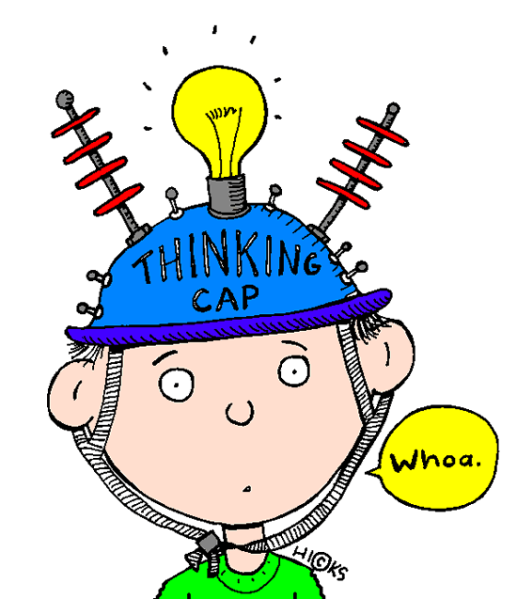
69

Slide 70
Think, Write, Pair, Share
Advantages of having English learners in your class
Challenges of having English learners in your class
Key strategies to teach literacy to English learners
Questions I have about teaching literacy to English learners

Slide 71
References (1)
August, D., & Shanahan, T. (Eds.) (2008). Developing reading and writing in second-language learners. Lessons from the report of the National Literacy Panel on Language-Minority Children and Youth. Florence, KY: Routledge. The Center for Applied Linguistics and the International Reading Association.
August, D., Carlo, M., Dressler, C., & Snow, C. (2005). The critical role of vocabulary development for English language learners. Learning Disabilities Research & Practice, 20(1), 50–57.
Calderon. (2008, April). ESL Strategies for teaching vocabulary and reading. Paper presented at the annual meeting of Teachers of English to Speakers of Other Languages (TESOL), New York, NY.
Carlo, M.S., August, D., McLaughlin, B., Snow, C.E., Dressler, C., Lippman, D., Lively, T., White, C. (2003). Closing the gap: Addressing the vocabulary needs of English language learners in bilingual and mainstream classrooms. Reading Research Quarterly, 39(2), 188-315.

Slide 72
References (2)
Cloud, N., Genesee, F., & Hamayan, E. (2009). Literacy instruction for English language learners: A teacher’s guide to research-based practices. Portsmouth, NH: Heinemann
Drucker, M. J (2003). What reading teachers should know about ESL learners. The Reading eacher. Vol 57 (1): p.22-29; retrieved on Nov 6, 2004 from www.questia.com
Echevarria, J. & Hasbrouck, J. (2009). Response to intervention and English learners. Washington, DC: Center for Research on the Educational Achievement and Teaching of English Language Learners. Retrieved from http://www.cal.org/create/resources/pubs/CREATEBrief_ResponsetoIntervention.pdf
Echevarria, J., Vogt, M.E., & Short, D. (2008). Making Content Comprehensible for English learners: The SIOP model (3rd ed.). Boston: Allyn & Bacon.

Slide 73
References (3)
Goldenberg, C. (2008). Teaching English language learners: What the research does—and does not—say. American Educator, 32(2), 8-22, 42-44. Retrieved July 6, 2010 from the American Educator Web site: http://www.aft.org/pubs-reports/american_educator/issues/summer08/goldenberg.pdf
Institute of Education Sciences (IES). (2007). Effective literacy and English language instruction for English language learners in the elementary grades. Washington, DC: IES, National Center for Education Evaluation and Regional Assistance.
Orosco, M. J. & Klingner, J. (2010). One school’s implementation of RTI with English language learners: “Referring into RTI.” Journal of Learning Disabilities, 43(3), 269–288.
Short, D.J., & Fitzsimmons, S. (2007). Double the Work: Challenges and solutions to acquiring language and academic literacy for adolescent English language learners. New York: Carnegie Corporation.
Notes:
Add a few more references: Klingner 2010 (confirm) and Le

Slide 74
References (4)
Tharp, R. G. (1997). From at-risk to excellence: Research, theory, and principles for practice (Research Report 1). Santa Cruz, CA: Center for Research on Education, Diversity & Excellence. Retrieved July 6, 2010 from: http://www.cal.org/resources/Digest/crede001.html
Trumbull, E., & Pacheco, M. (2005). Leading with diversity: Cultural competencies for teacher preparation and professional development. Providence, RI: The Education Alliance at Brown University and Pacific Resources for Education and Learning.

